Slide 1
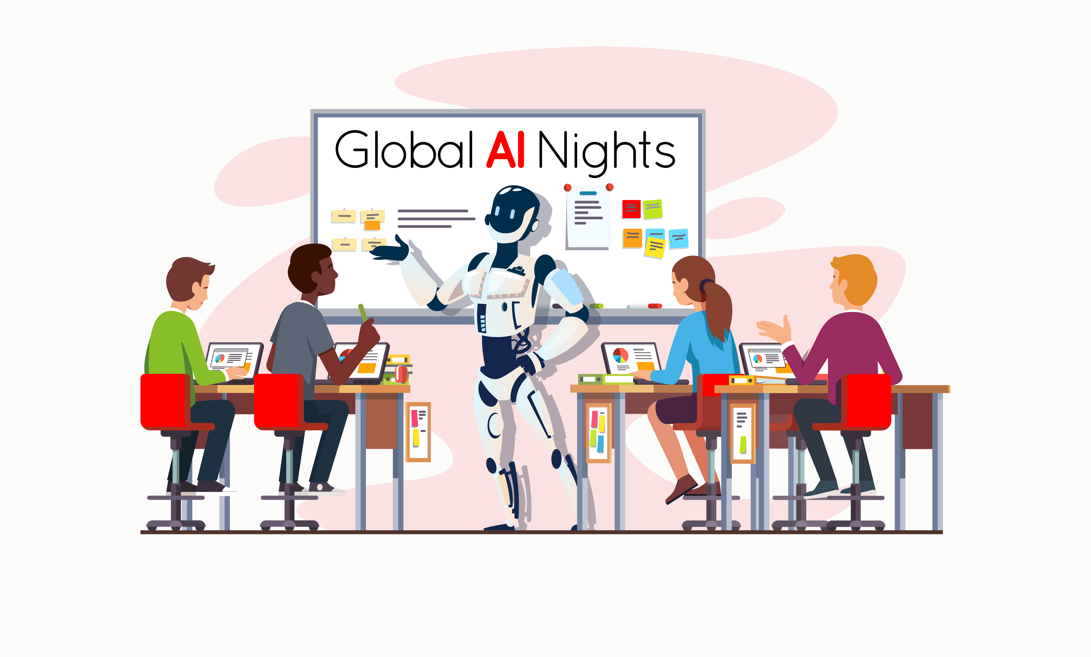

#AzureSkane
#GlobalAINight

Slide 2
Today’s agenda
17:15 – 17:30 Meet & Greet 17:30 – 17:45 Global AI Keynote 17:45 – 18:30 Ashok - Making your ML / AI production ready 18:30 – 18:50 Break & Pizza 18:50 – 19:35 Mattias - Why AI/ML projects are different 19:35 – 19:45 Handouts, Lab intro and wrap up

Slide 3
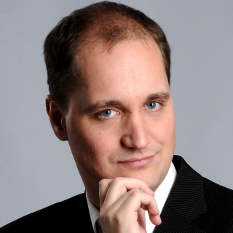
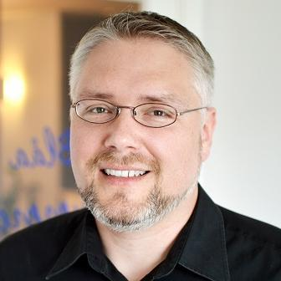
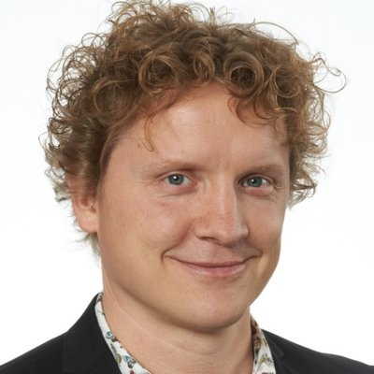
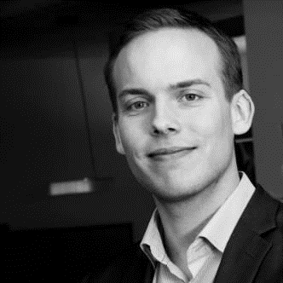
Skåne Azure User Group organizers
Johan Åhlén Michael Jonsson
Magnus Mårtensson Robin Carlsson

Slide 4

A BIG thank you to our host!

Slide 5
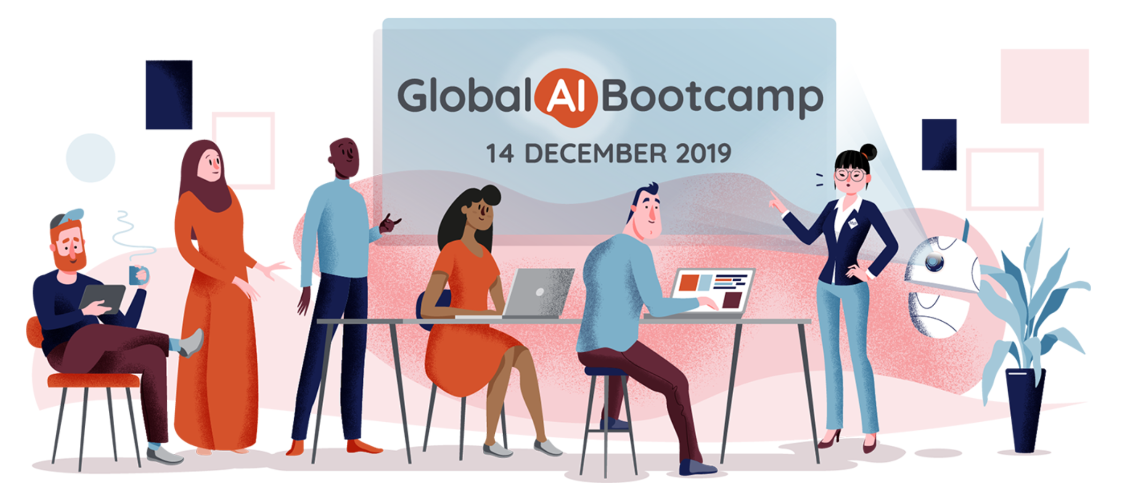
Save the date!
14 December, 2019

Slide 6
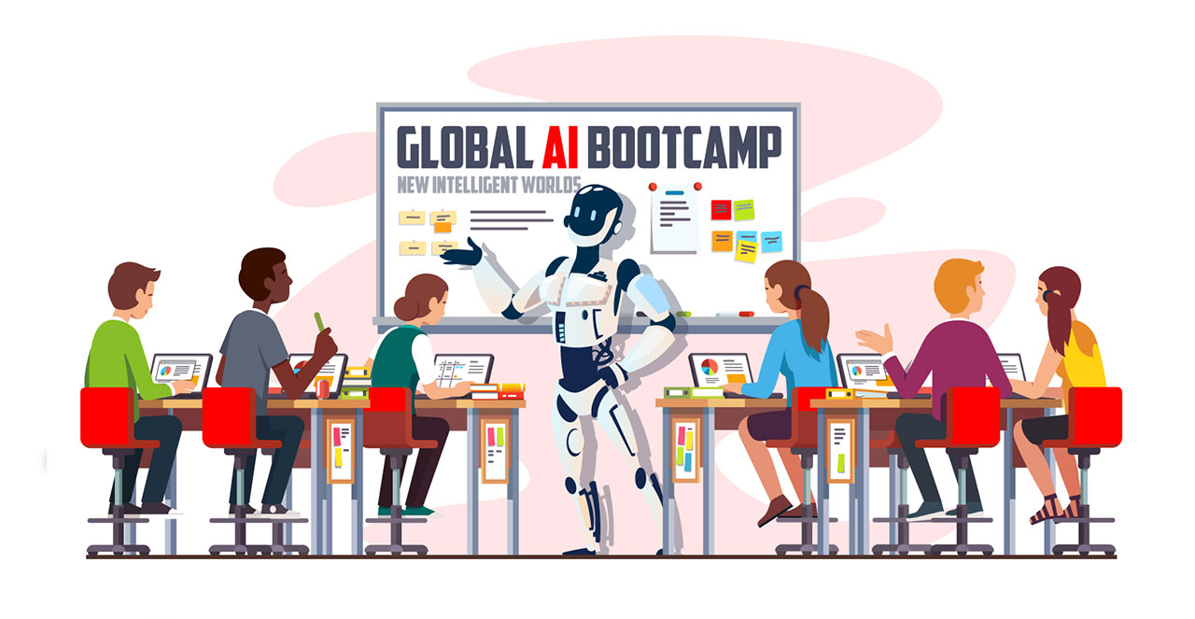
Let’s go!

Slide 7
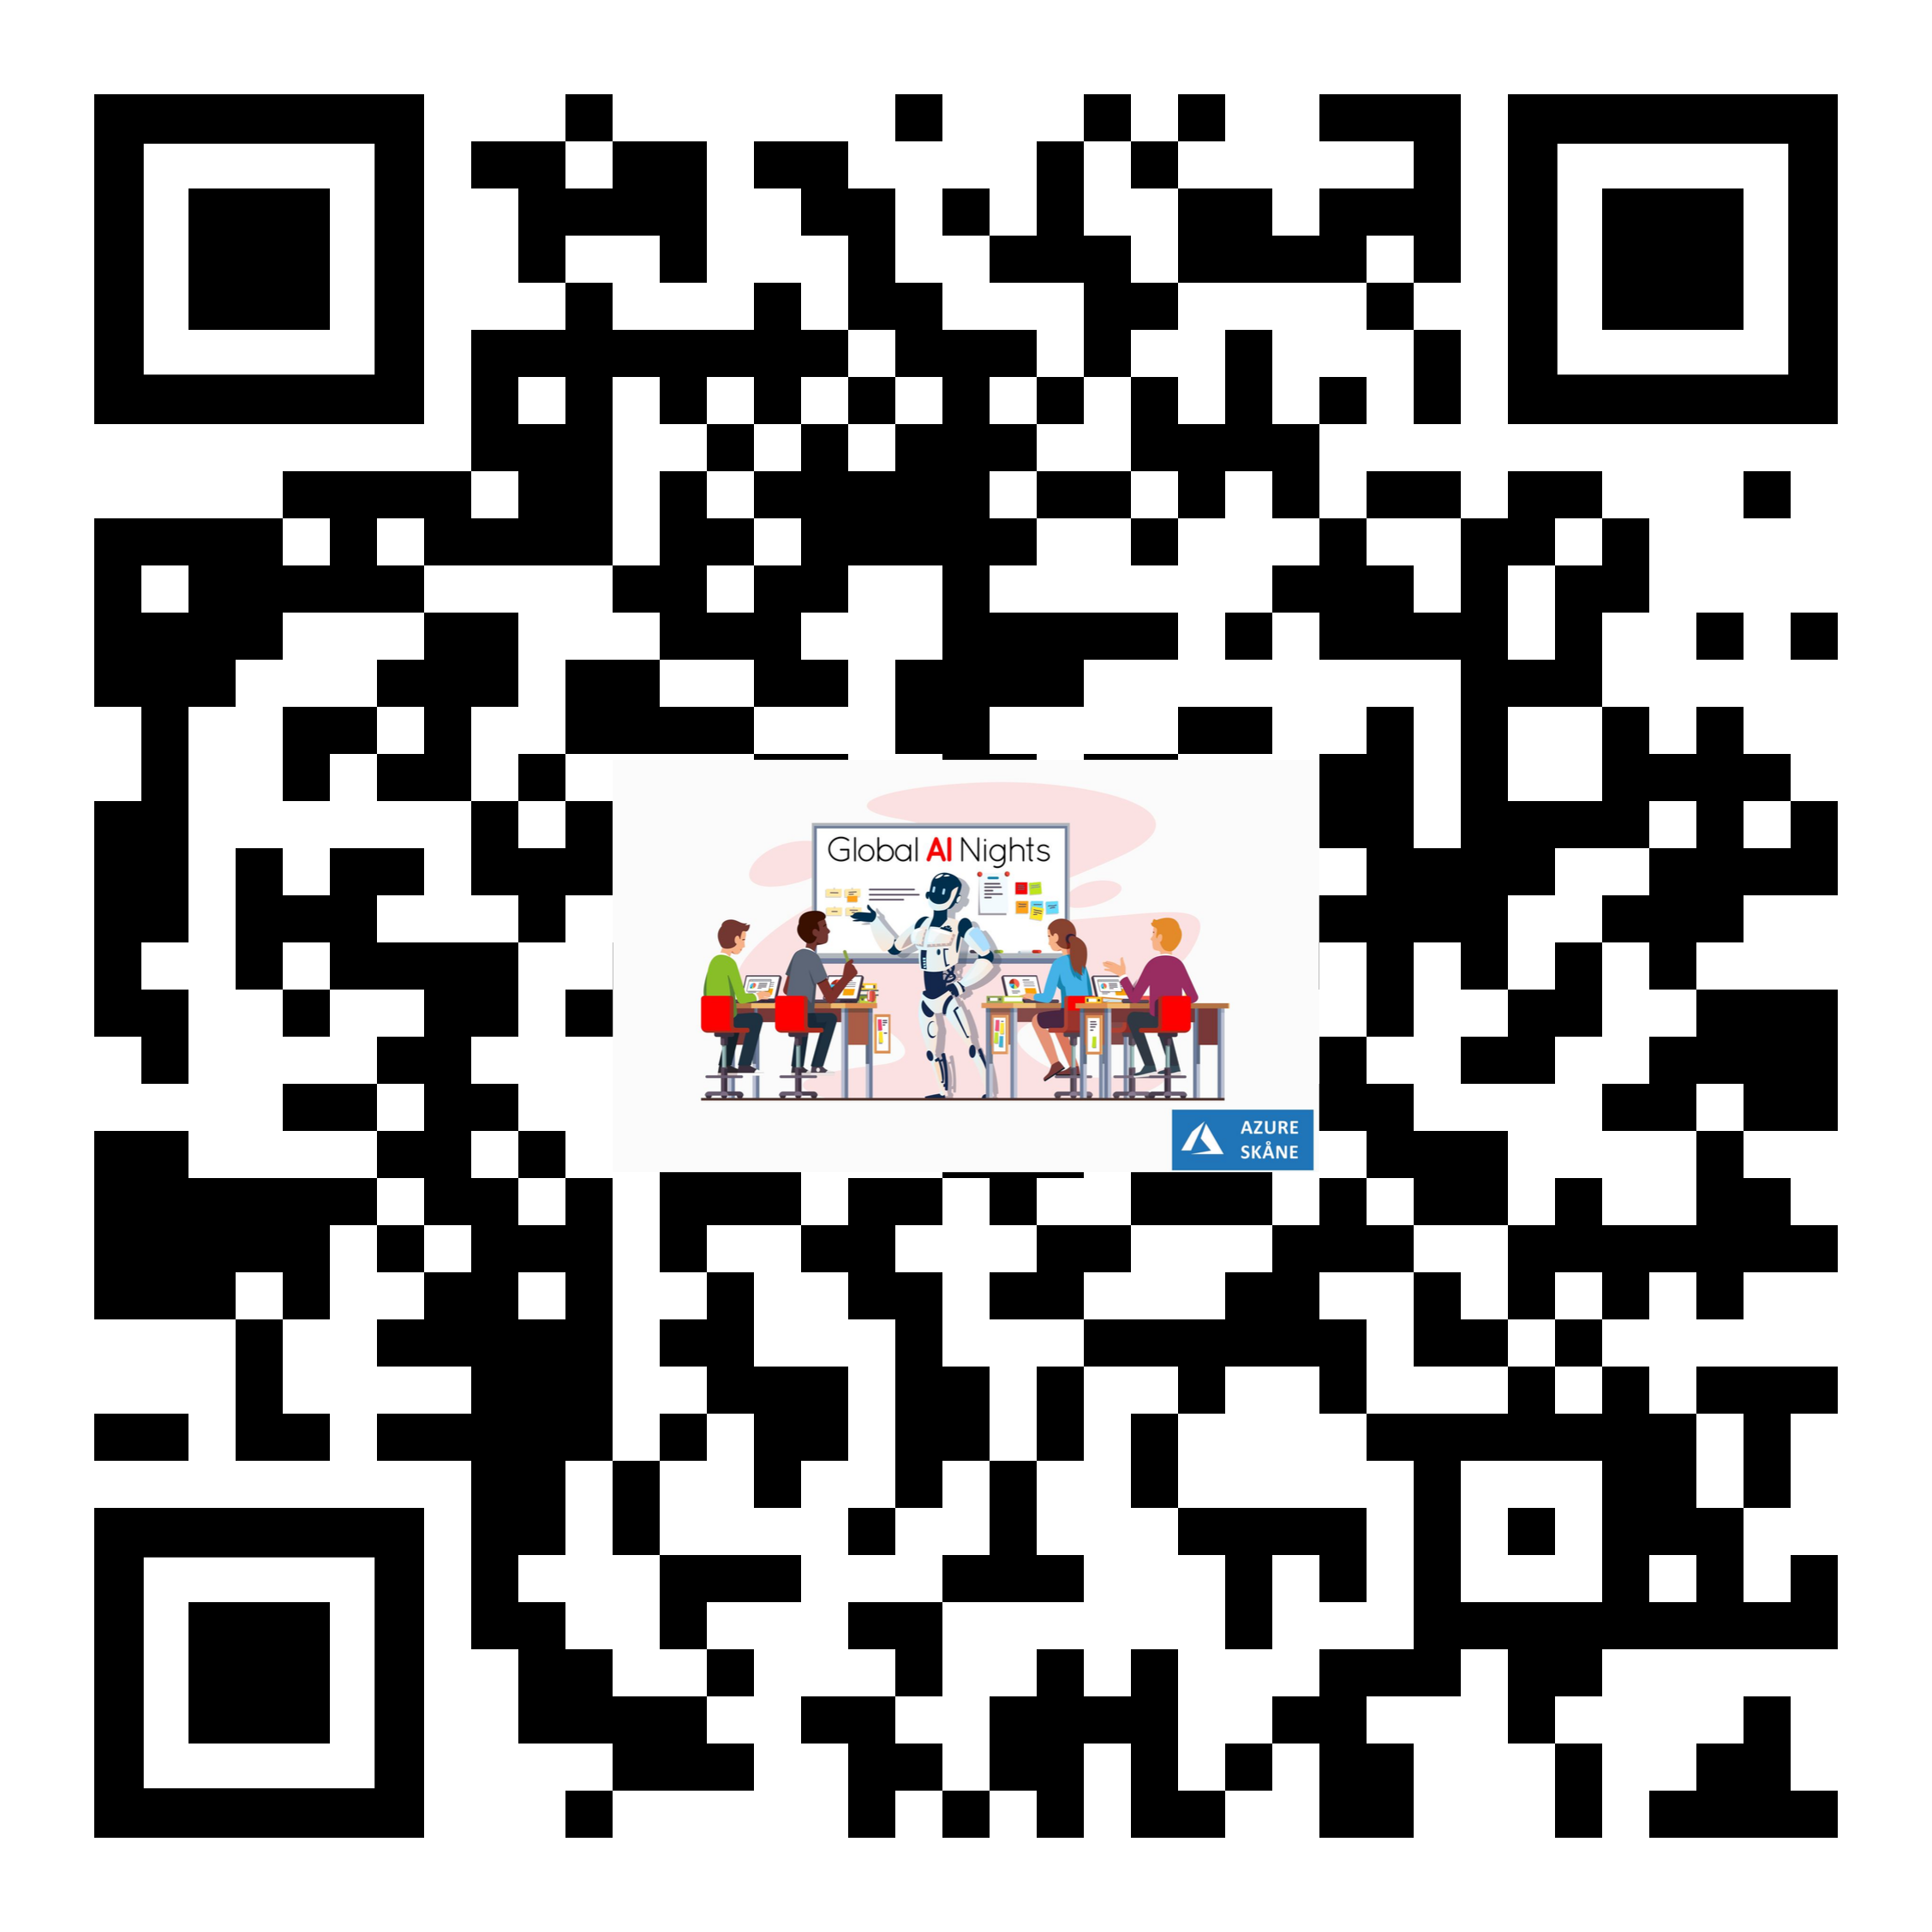
Survey:
https://www.surveymonkey.com/r/7TSKYGP
Social media:
#AzureSkane
#GlobalAINight

Slide 8
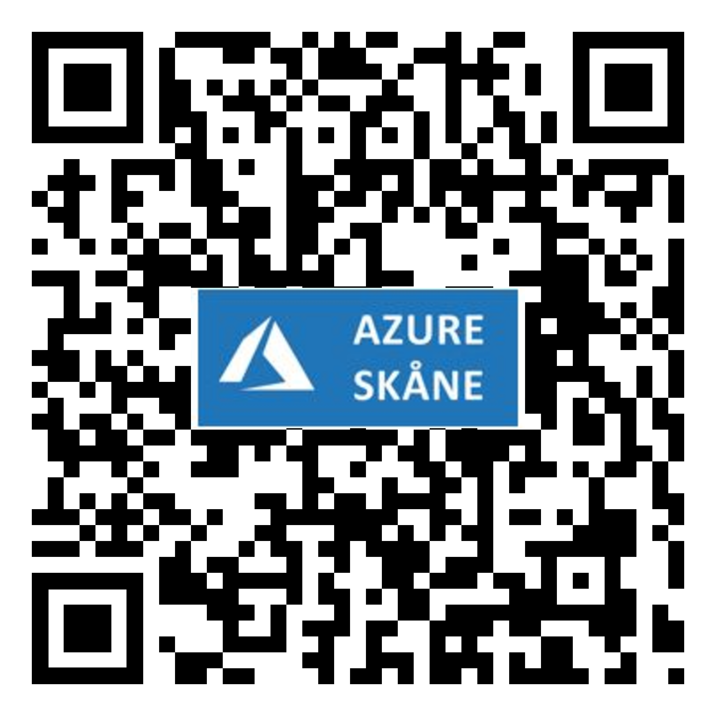
All stuff in one link!
https://www.theurlist.com/azureskaneglobalainight
Except - https://globalai.community/

Slide 9
Azure Passes for the Labs
Attendees can redeem the codes at: https://www.microsoftazurepass.com/.
Unlike the regular free trial, you do not need to enter a credit card to use an Azure pass.
The passes will activate on September 4th and remain active for 7 days.
Materials for all sessions can be found here: https://github.com/GlobalAICommunity/GlobalAINight-September-2019 )
Beginner Track: Creating applications that can see, hear, speak or understand - using Microsoft Cognitive Services
Beginner Track: Is that wine good or bad? A beginner tutorial on how to build a binary classification machine learning model with no code using Azure Machine Learning Visual Interface
Intermediate Track: Learn how to train high accuracy machine learning models using automated machine learning
Intermediate Track: Crash course on building and accelerating deep learning solutions
Bonus content
We have also added some fantastic content on ML.NET provided by Mark Tabladillo, Cloud Solution Architect, Microsoft. Mark has these sessions already recorded and avalibale on YouTube, links are available within the GitHub repo above.

Slide 10
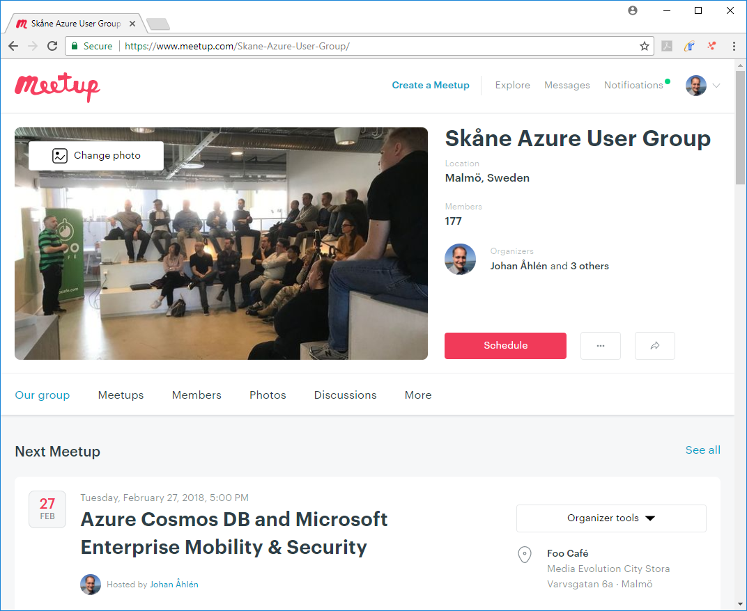
Meetup
Register at
https://www.meetup.com/Skane-Azure-User-Group
to receive invitations and presentation material.

